Slide 1
Brain Parts Trivia

Slide 2
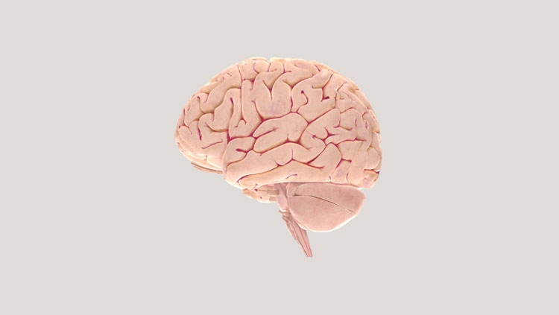
About how much does the average adult human brain weigh?
1 pound
3 pounds
5 pounds
10 pounds
A depiction of the human brain. BrainFacts’ 3D Brain.
The Society for Neuroscience, 2017

Slide 3
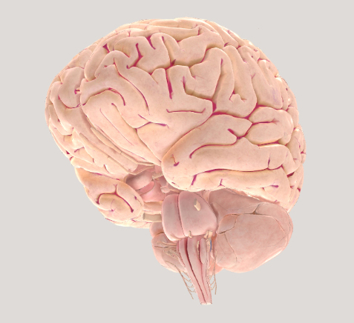
About how much does the average adult human brain weigh?
1 pound
3 pounds
5 pounds
10 pounds
The average adult brain weighs around three pounds.
It controls everything you do: from heartbeat to memory storage and much more.
A depiction of the human brain. BrainFacts’ 3D Brain.
The Society for Neuroscience, 2017

Slide 4
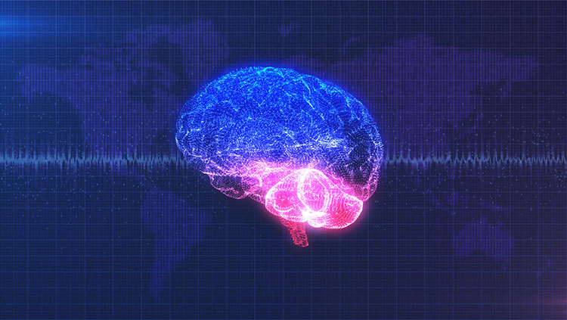
To the nearest BILLION, about how many cells (not just neurons) does the human brain contain?
46 billion
86 billion
170 billion
240 billion
ICYMI: Detailed Brain Atlas Offers New Insights into Human Brain. BrainFacts, 2023
Wangber/Shutterstock

Slide 5
To the nearest BILLION, about how many cells (not just neurons) does the human brain contain?
46 billion
86 billion
170 billion
240 billion
There are 86 billion neurons in the human brain. But there are also many other cells in the brain, too.
Altogether, researchers believe there are around 170 billion cells in the human brain. These cells work together to coordinate everything you do.
ICYMI: Detailed Brain Atlas Offers New Insights into Human Brain. BrainFacts, 2023
Wangber/Shutterstock

Slide 6
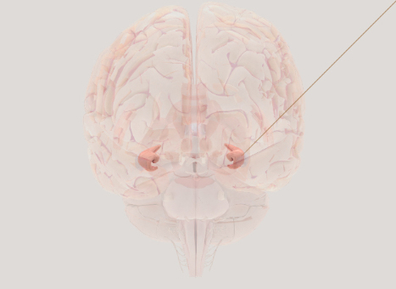
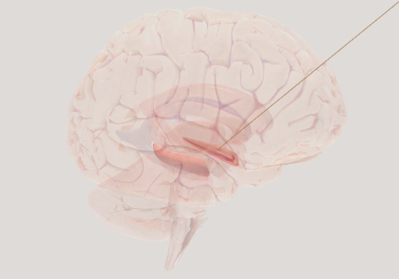
The hippocampus controls all rational and logical decision-making.
True
False
Depictions of the human hippocampus. BrainFacts’ 3D Brain.
The Society for Neuroscience, 2017

Slide 7

The hippocampus controls all rational and logical decision-making.
True
False
The hippocampus is primarily responsible for learning and memory, not controlling decision-making.
Making Memories. BrainFacts, 2018
mei.si/Shutterstock

Slide 8
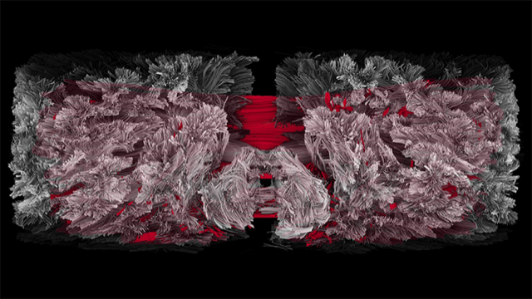
What connects the left and right hemispheres of the brain?
Cerebral cortex
Corpus callosum
Medulla oblongata
Thalamus
It Takes Two Hemispheres to Talk. BrainFacts, 2018
Katia Heuer and Roberto Toro

Slide 9
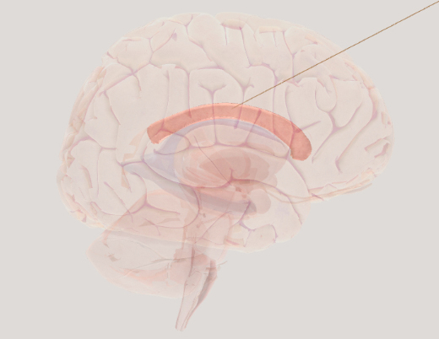
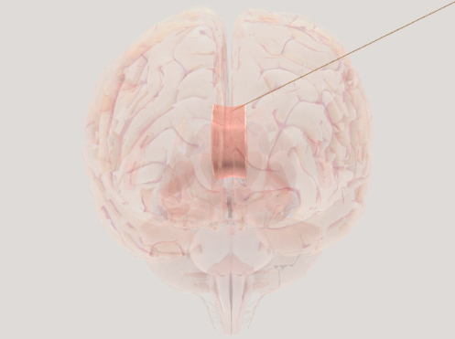
What connects the left and right hemispheres of the brain?
Cerebral cortex
Corpus callosum
Medulla oblongata
Thalamus
The corpus callosum is a large bundle of nerve fibers linking the left side of your brain to the right side.
It acts as a superhighway, helping information to flow across the brain.
Depictions of the human corpus callosum. BrainFacts’ 3D Brain.
The Society for Neuroscience, 2017

Slide 10
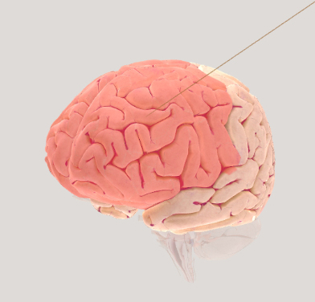
At about what age does the frontal lobe finish developing?
15-20 years
25-30 years
35-40 years
40-45 years
A depiction of the human frontal lobe. BrainFacts’ 3D Brain.
The Society for Neuroscience, 2017

Slide 11

At about what age does the frontal lobe finish developing?
15-20 years
25-30 years
35-40 years
40-45 years
The frontal lobe — helping control movement, plan behaviors, and make decisions — doesn't finish developing until a person's mid-to-late-20s.
When the Brain Starts Adulting. BrainFacts, 2018
Sean Locke Photography/Shutterstock

Slide 12
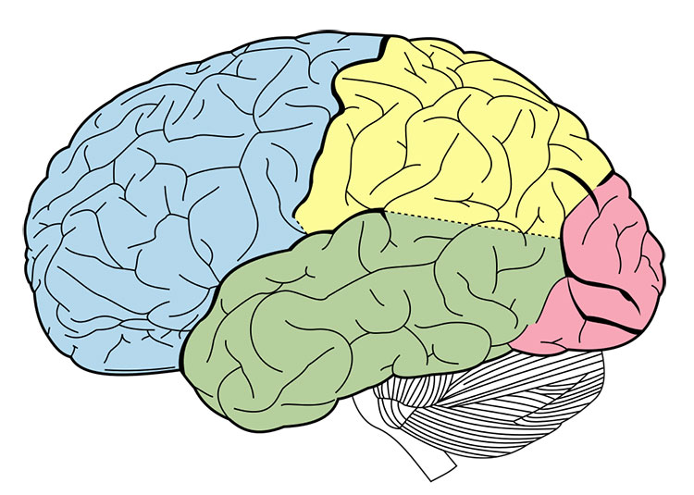
Which cortical lobe processes sound?
Temporal lobe
Parietal lobe
Occipital lobe
Frontal lobe
The brain has four lobes:
The frontal lobe, labeled blue;
The parietal lobe, labeled yellow;
The temporal lobe, labeled green;
And the occipital lobe, labeled pink.
Identifying Major Brain Landmarks. BrainFacts, 2018
Henry Vandyke Carter/Wikimedia Commons

Slide 13
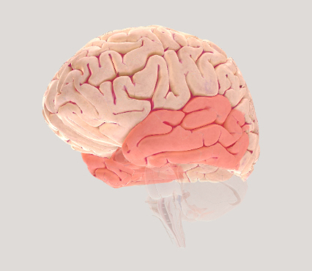
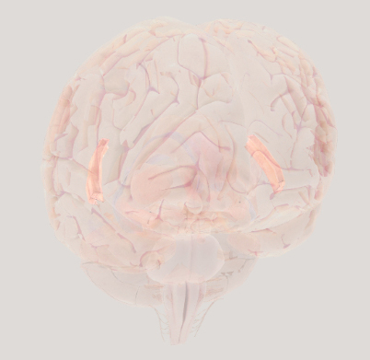
Which cortical lobe processes sound?
Temporal lobe
Parietal lobe
Occipital lobe
Frontal lobe
In the temporal lobe, a region called the primary auditory cortex is responsible for processing auditory information (sound).
Depictions of the temporal lobes (left) and primary auditory cortex (right). BrainFacts’ 3D Brain.
The Society for Neuroscience, 2017

Slide 14
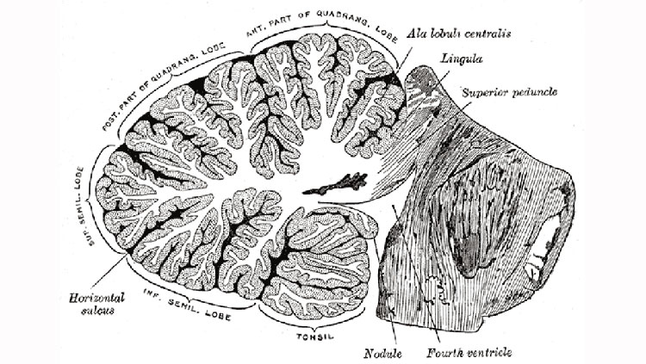
Which of the following is NOT a function of the cerebellum?
Coordinating movement
Maintaining balance
Processing emotions
Regulating heartbeat
A cross-section drawing of the human cerebellum. The Mysterious, Multifaceted Cerebellum. BrainFacts, 2020
H.V. Carter/Wikimedia Commons. Gray’s Anatomy, 1918

Slide 15
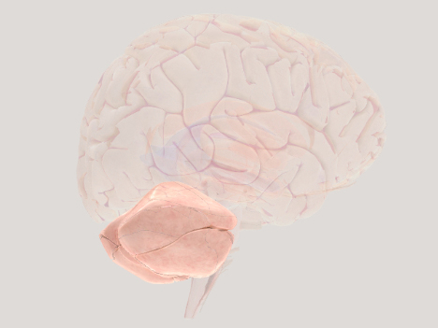
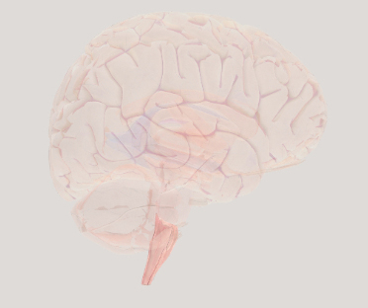
Which of the following is NOT a function of the cerebellum?
Coordinating movement
Maintaining balance
Processing emotions
Regulating heartbeat
The cerebellum helps with motor control, movements, and emotional processing. It contains more neurons than any other brain region.
The medulla oblongata in the brainstem is the part of the brain that helps to control your heartbeat.
Depictions of the human cerebellum (left) and medulla oblongata (right). BrainFacts’ 3D Brain.
The Society for Neuroscience, 2017

Slide 16
How did you do?
Visit BrainFacts to learn more.

